Slide 1
Irrigation Prediction
Adrien Chabert

Slide 2






Slide 3


200’000 km³ of fresh water
Notes:
200’000 km3 of fresh water on earth
2/3 for irrigation
Decrease water consumption of 20%-25%

Slide 4
Research of Literature
Collect Data
Integration of Machine Learning Algorithm
Test our result
Create a watering plan

Slide 5
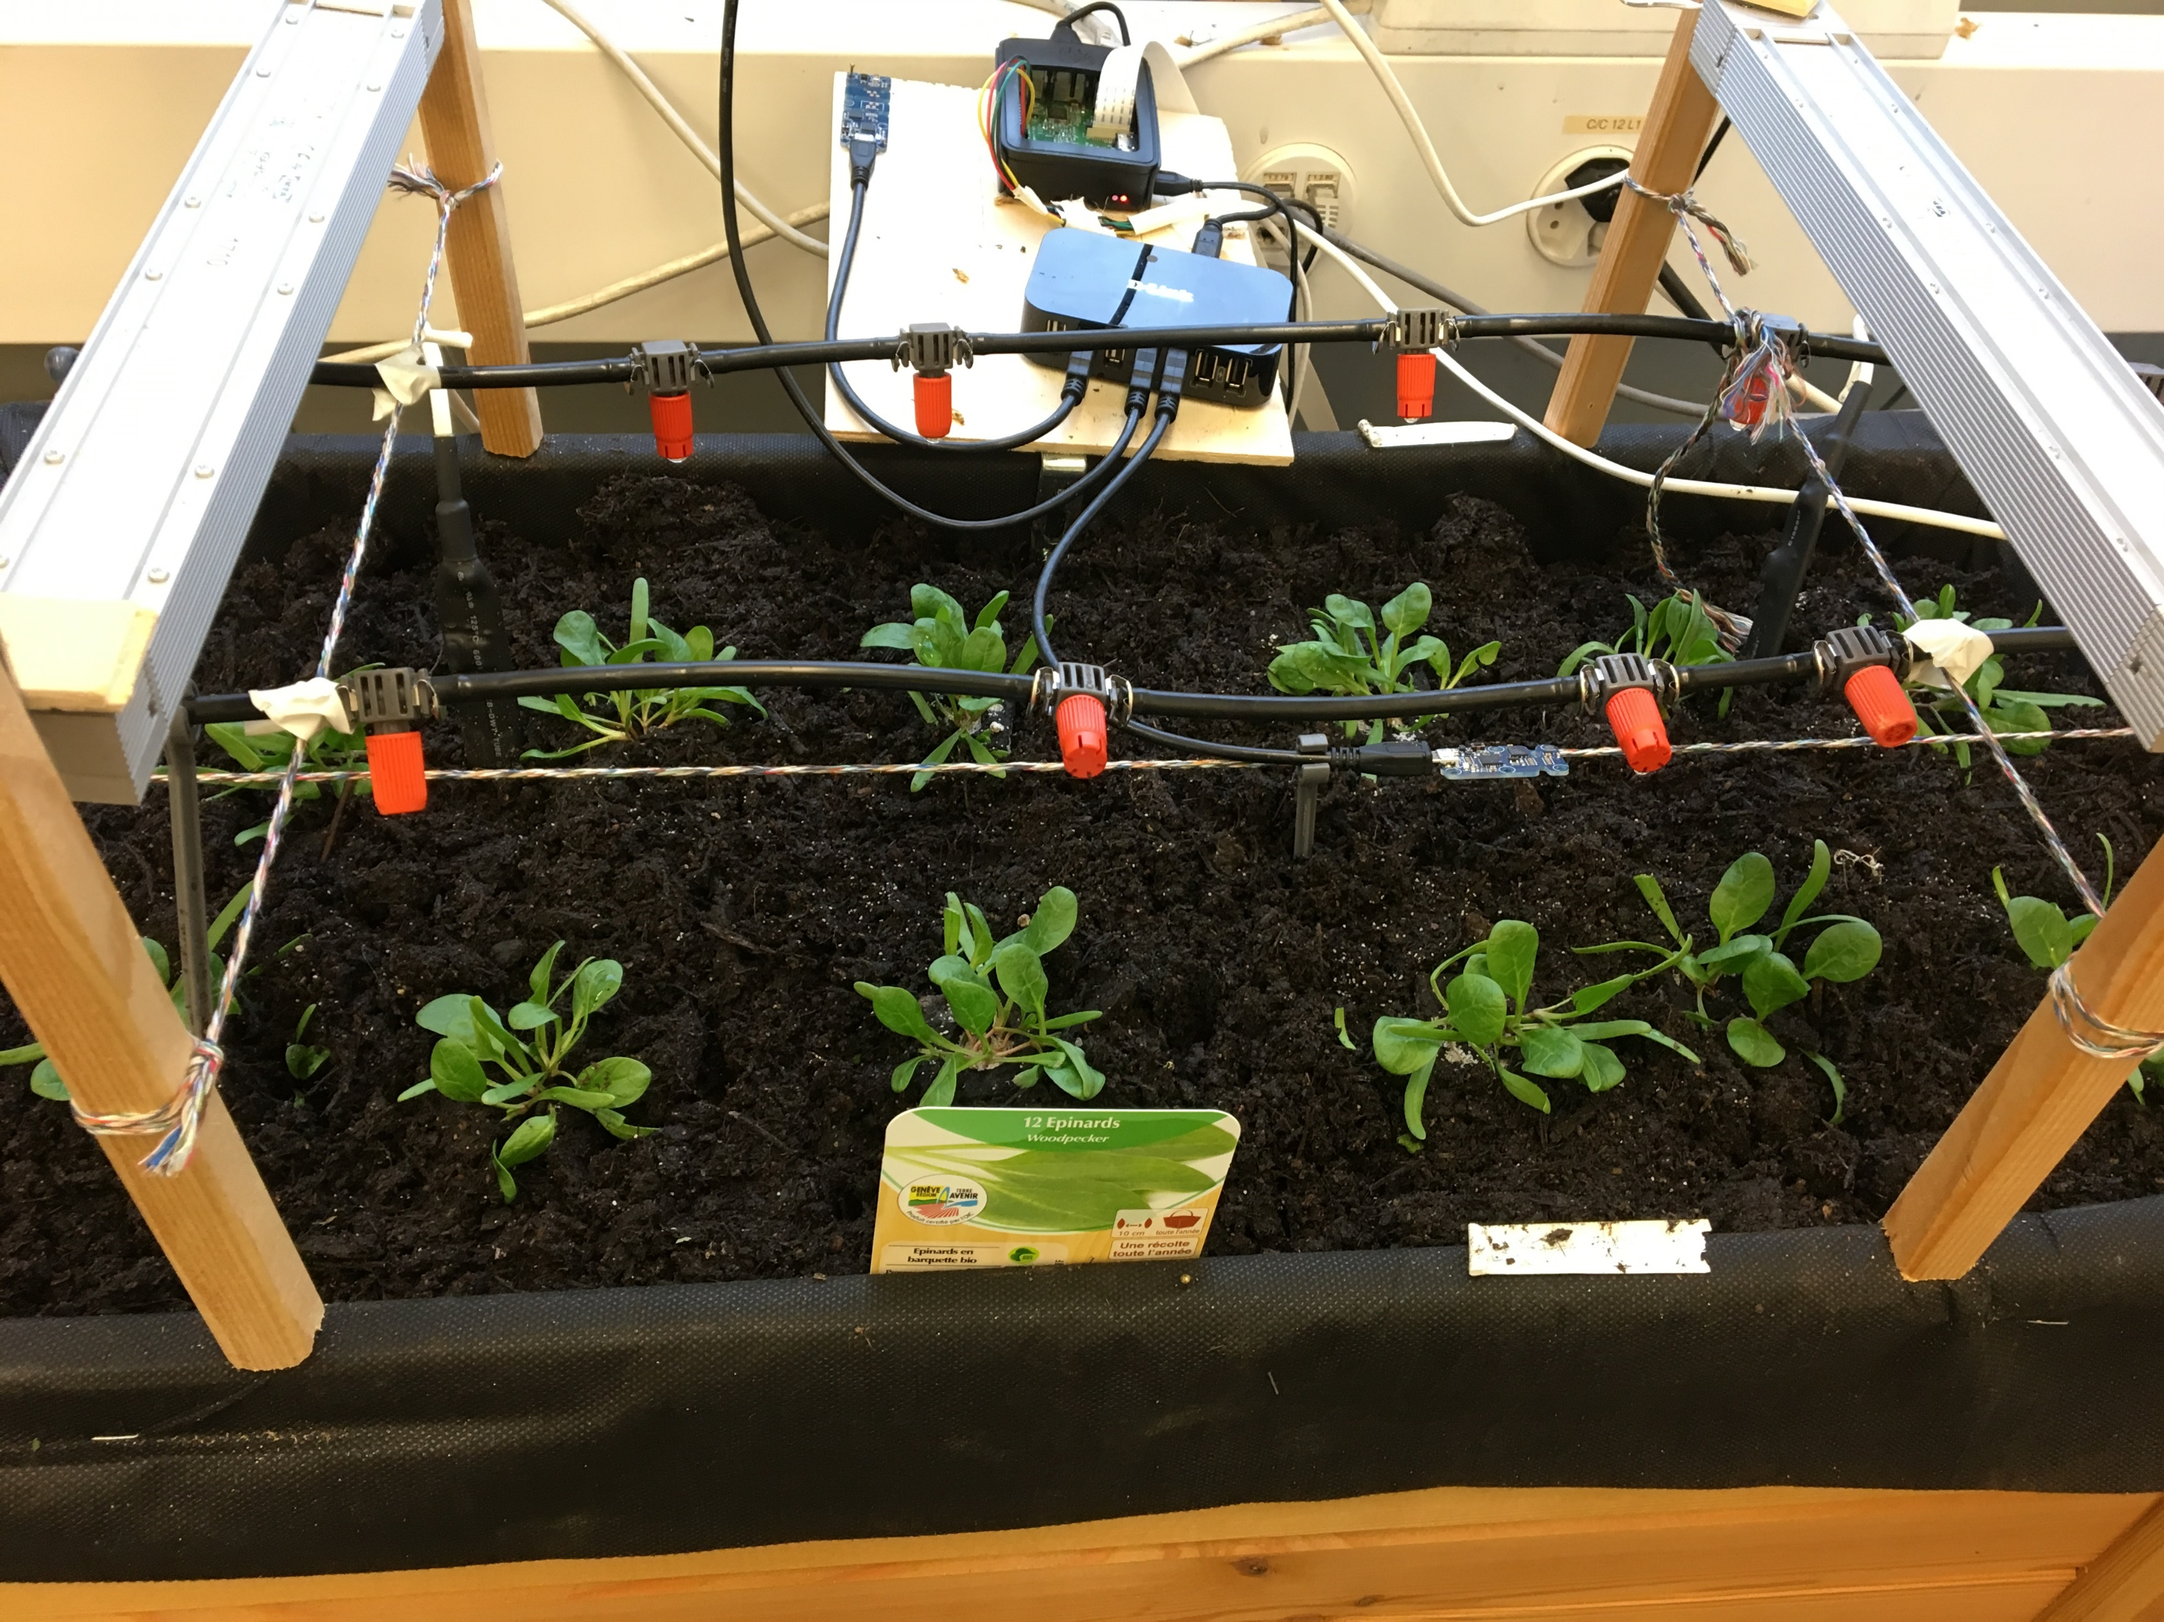
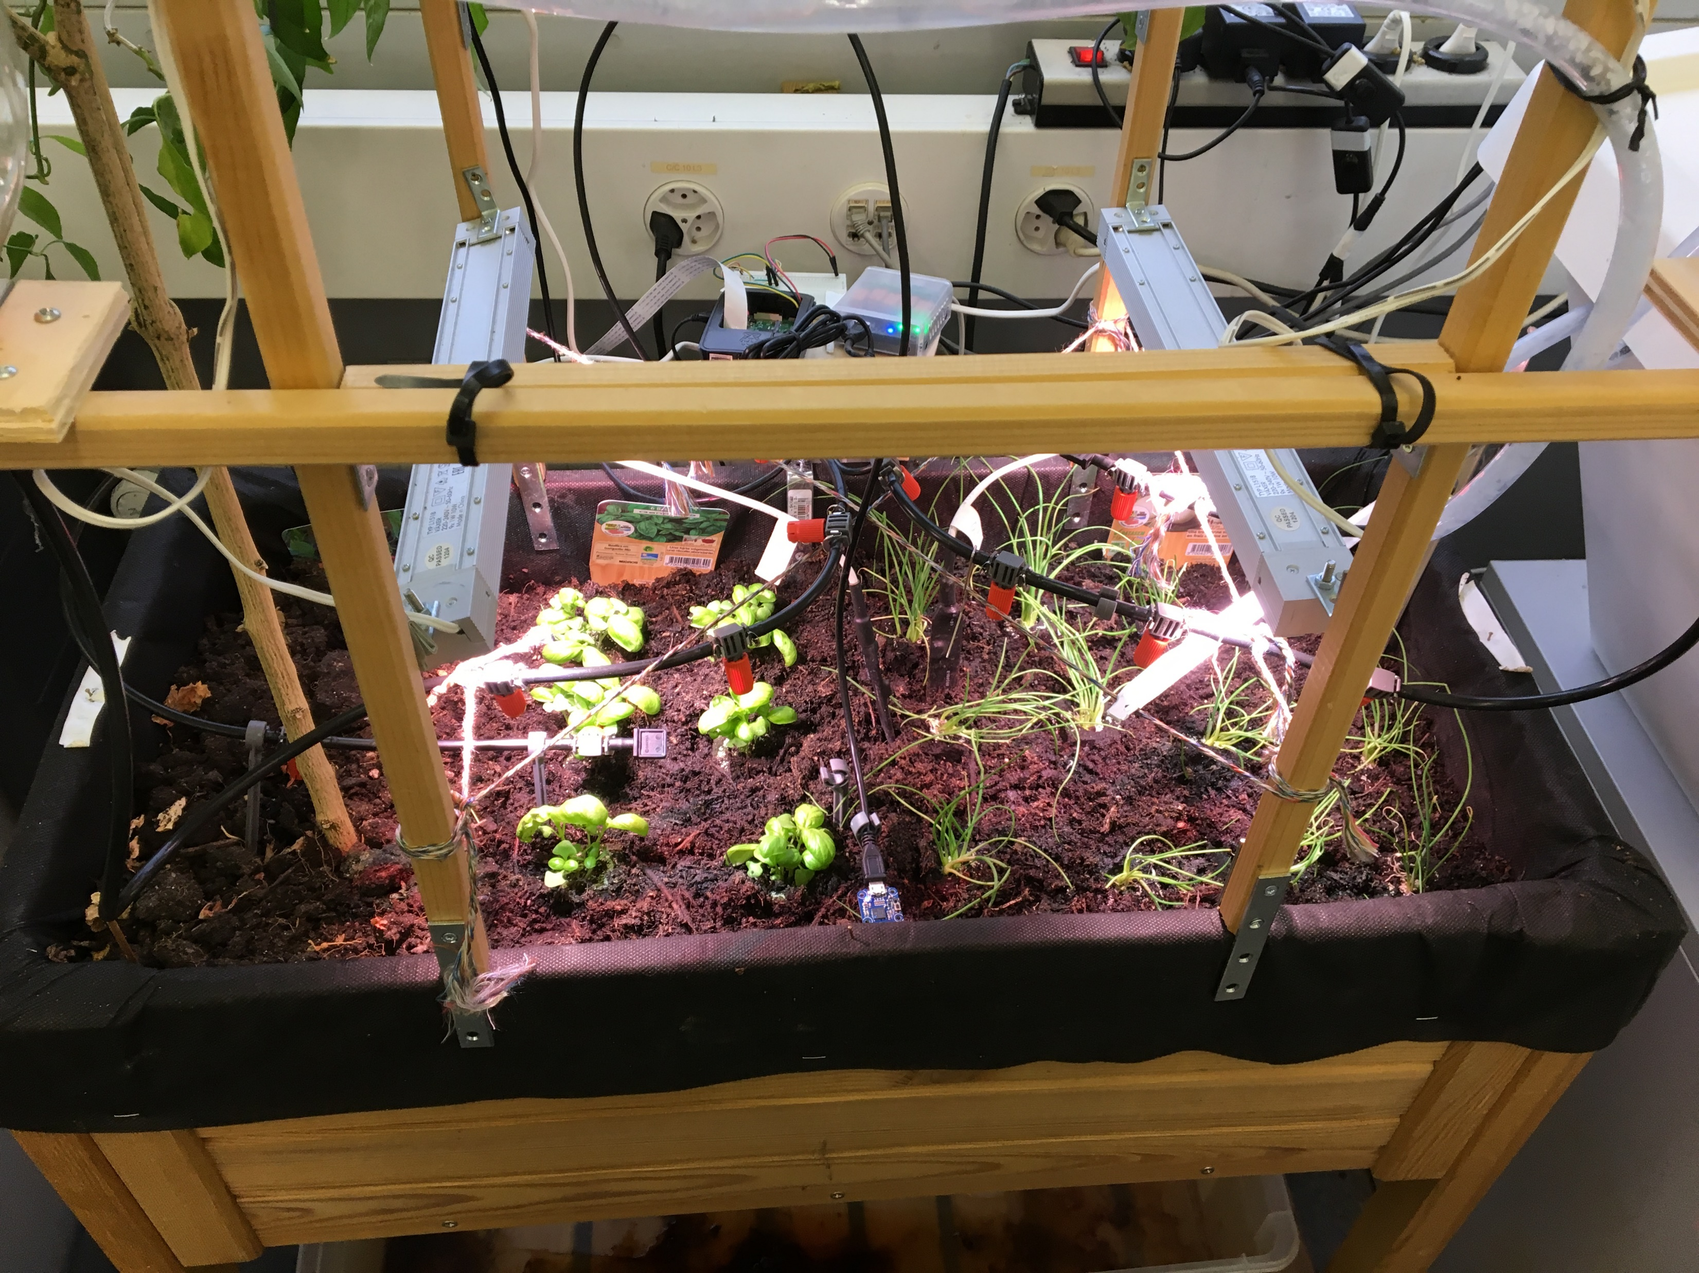
Planting
Basilic, onion, spinach

Slide 6
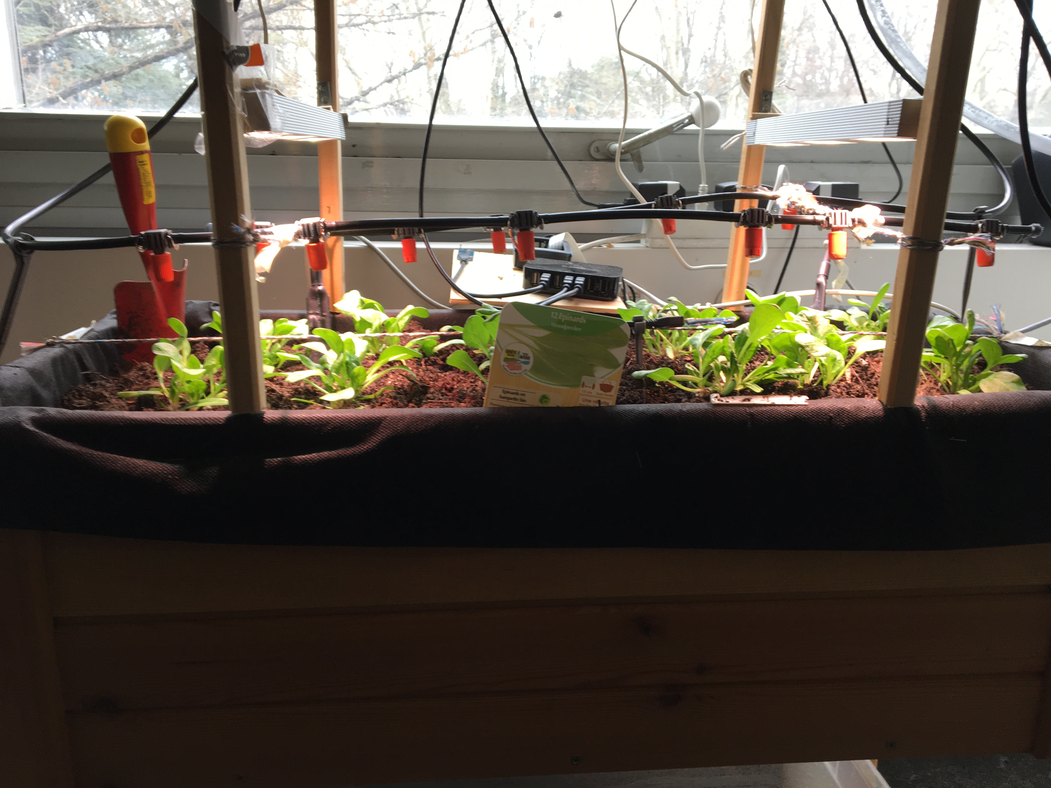
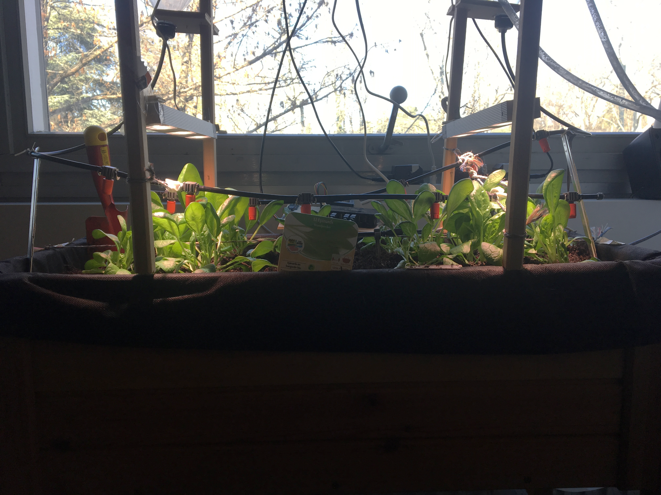
13 mars
20 mars

Slide 7






Slide 8
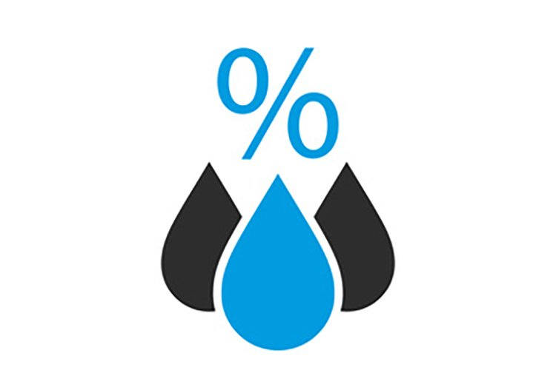
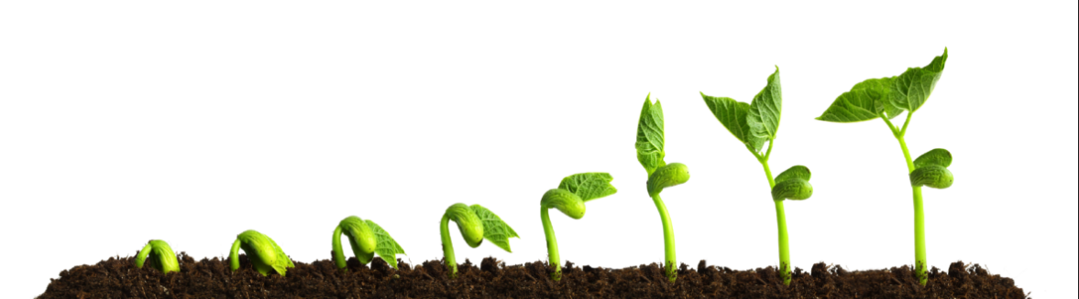


Notes:
Le vent impacte également mais pas dans notre cas

Slide 9
Problems from last meeting
Position of the humidity sensor
Defective Captor
Pandas and Matplotlib not working on Jupyter
Difficulty to implement ML
Lack of knowledge of ML

Slide 10
What I did with my data
Reading data in dataframe
Add information on my dataframe
Implement some different strategy
Eliminate NaN value
Analyse result
Watering
Time since watering

Slide 11
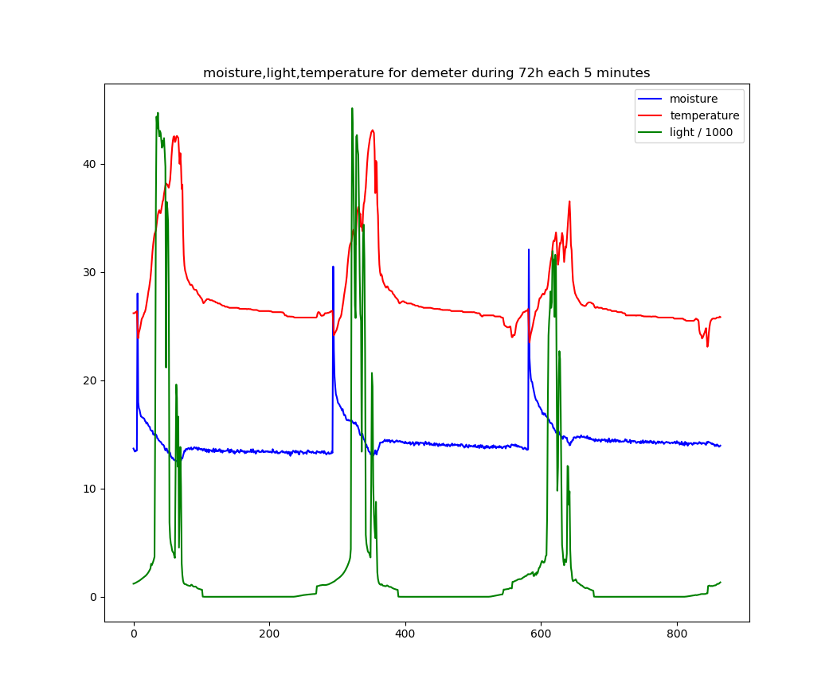
Notes:
Lumière : Lux . 10 = 10k Lux

Slide 12
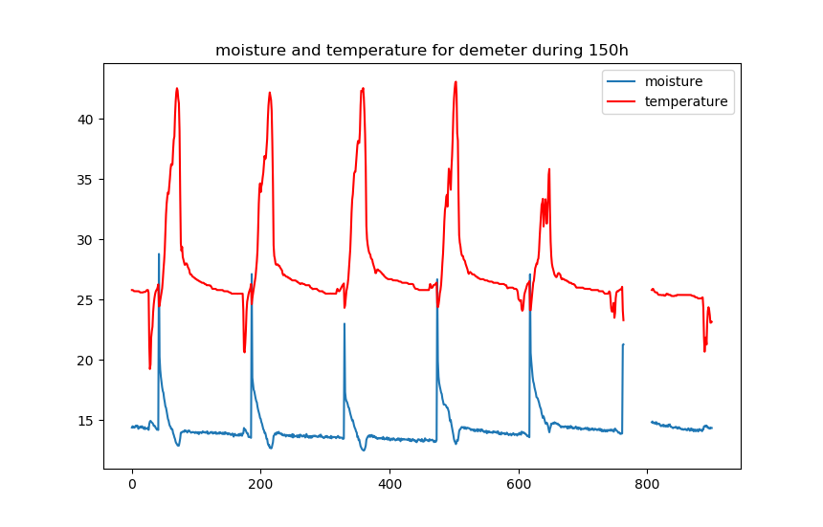
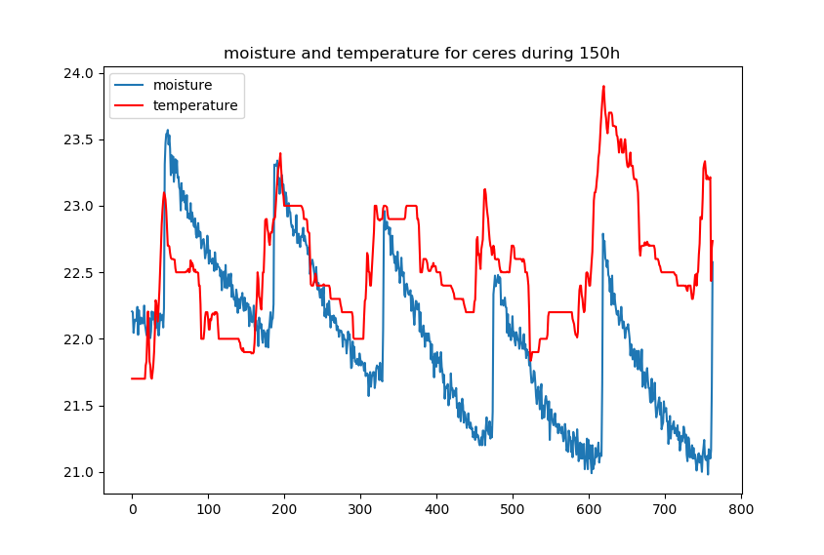

Slide 13
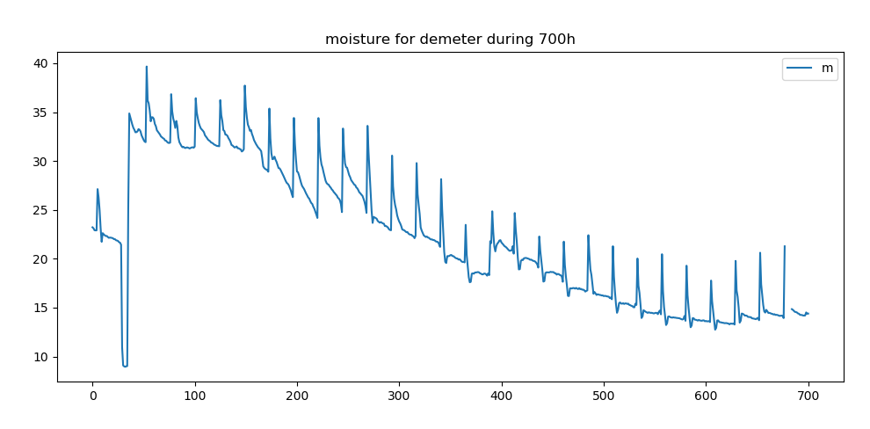
Moisture
porcent

Slide 14
Date | Demeter | Ceres
6-Mar | 10 s/j | 10 s/j
13-Mar | 10 s/j | 10 s/j
20-Mar | 10 s/j | 10 s/j
27-Mar | 20 s/j | 15 s/j
3-Apr | 20 s/j | 15 s/j
10-Apr | 20 s/j | 15 s/j
17-Apr | 40 s/j | 30 s/j
24-Apr | 40 s/j | 30 s/j
1-May | 40 s/j | 30 s/j
3-May | 35s/j | 20 s/j
8-May
15-May
Watering Plan

Slide 15
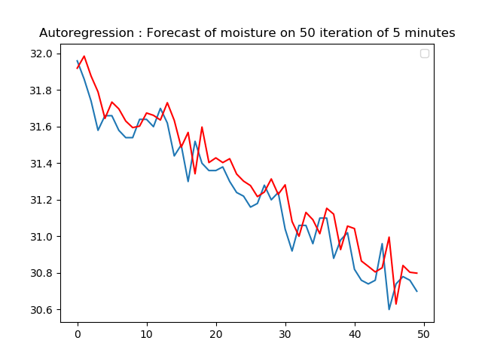
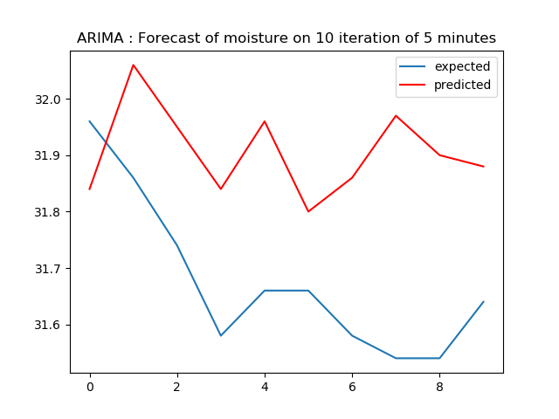
Test_MSE : 0.017
Test_MSE : 0.073
Notes:
ARIMA : Autoregressive integrated moving average
Non stationarity,
AR : Autoregression
MA : linear regression error
I for integrate

Slide 16
Planning for the next 3 weeks
To move on with my final written report
Analyse and chose the better algorithm
Create a watering programme
In function of the forecast
Watering forecast on some day
Notes:
Ou Bayesian learning machine approach for Regression

Slide 17
Project Planning

